Slide 1
Courbes
de Bézier
...

Slide 2
Courbes de Bézier
Une courbe de Bézier peut être de premier degré, quadratique, ou plus
La célèbre courbe de Bézier est celle de quatrième degré, dite aussi cubique
Notes:
https://en.wikipedia.org/wiki/B%C3%A9zier_curve

Slide 3
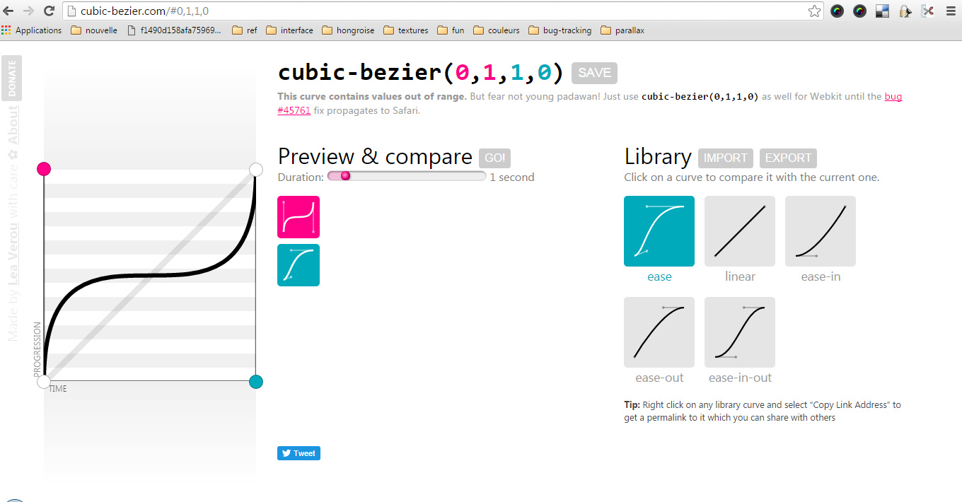

Slide 4
Liens
https://www.codeproject.com/Articles/25237/Bezier-Curves-Made-Simple#
https://developer.apple.com/library/archive/documentation/2DDrawing/Conceptual/DrawingPrintingiOS/BezierPaths/BezierPaths.html#
https://www.html5canvastutorials.com/tutorials/html5-canvas-bezier-curves/#
https://www.sitepoint.com/html5-canvas-draw-bezier-curves/#

Slide 5


And now what?
Download More Free PowerPoint Templates
You can safely delete this slide, but please consider to read below:
Congratulations
You can use this free PowerPoint template for your own presentations. Follow us on Twitter @ppttemplatenet
PPTTemplate.net
Did you know?
When you finish your PowerPoint presentation, you can upload it to:
SlideOnline.com

